Slide 1



Create a Content Provider & SQLiteDatabase

Slide 2
Introduction
A Uniform Resource Identifier (URI) is a unique sequence of characters to identify a specific resource.
URI can be for any resource such as table, information, row, web page, etc.
URI consists of:
Authority: internet domain in reverse similar to package name followed by “.provider”
Path: usually Authority is followed by the /table_name. it does not have to be table_name and can be different level of folders.
Optional Path: to specify the data type of the data (audio, video, etc).
Id: (optional) by convintion, developers usually provide id to specific row in the table.
content://com.example.app.provider/table3/6
Authority
Path
id=6
* Wild card for any string of character(s).
# Wild card for any string of number(s).

Slide 3
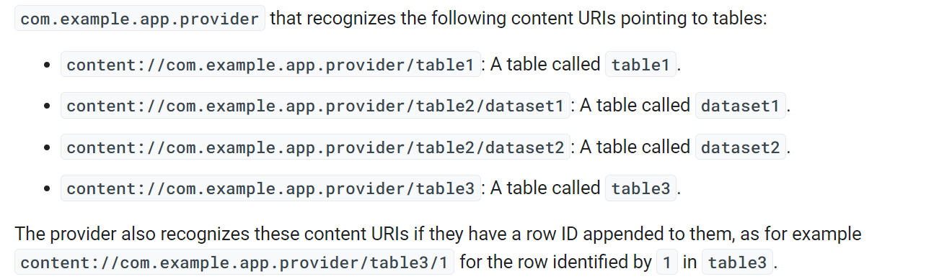
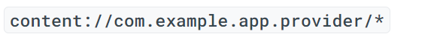
URI Examples
Matches any content URI in the provider.
Matches a content URI for the tables dataset1 and dataset2, but doesn't match content URIs for table1 or table3.

Slide 4
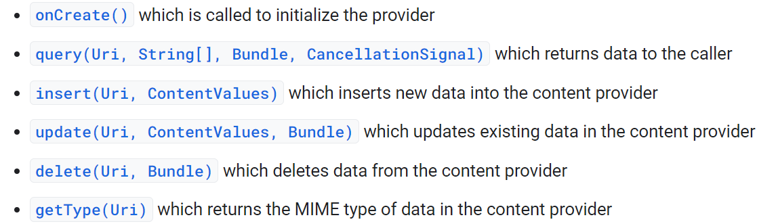
Implementing the ContentProvider class
ContentProvider is an abstract class.
By extending it, we must implement the following functions:

Slide 5
ContentProvider
Content Providers provide/encapsulate data through ContentResolver interface using specific URI.
Then, Android inspect the contact the ContentProvider that is specified in the Authority to access the required data.
They are used to mainly share data with other applications.
Within the app, we use direct access to database (SQLiteDatabase).
ContentProvider uses UriMatcher class to parse URIs.
Content providers must be declared in the manifest.

Slide 6
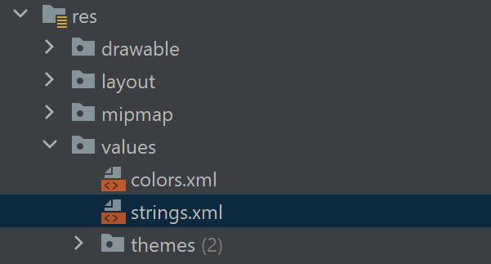
Read Contacts contents
Create a new app -> My Activity (default).
open AndroidManifest.xml
<?xml version="1.0" encoding="utf-8"?>
<manifest xmlns:android="http://schemas.android.com/apk/res/android"
package="com.example.myapplication">
<application
android:allowBackup="true"
android:icon="@mipmap/ic_launcher"
android:label="@string/app_name"
android:roundIcon="@mipmap/ic_launcher_round"
android:supportsRtl="true"
android:theme="@style/AppTheme">
<activity android:name=".MainActivity"
android:exported="true">
<intent-filter>
<action android:name="android.intent.action.MAIN" />
<category android:name="android.intent.category.LAUNCHER" />
</intent-filter>
</activity>
<provider android:name="StudentsProvider" android:authorities="com.example.MyApplication.StudentsProvider"/>
</application>
</manifest>

Slide 7
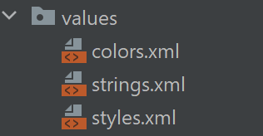
XMLs
<?xml version="1.0" encoding="utf-8"?> <resources> <color name="purple_200">#FFBB86FC</color> <color name="purple_500">#FF6200EE</color> <color name="purple_700">#FF3700B3</color> <color name="teal_200">#FF03DAC5</color> <color name="teal_700">#FF018786</color> <color name="black">#FF000000</color> <color name="white">#FFFFFFFF</color> <color name="colorPrimary">#008577</color> <color name="colorPrimaryDark">#00574B</color> <color name="colorAccent">#D81B60</color> </resources>
<resources> <!-- Base application theme. --> <style name="AppTheme" parent="Theme.AppCompat.Light.DarkActionBar"> <!-- Customize your theme here. --> <item name="colorPrimary">@color/colorPrimary</item> <item name="colorPrimaryDark">@color/colorPrimaryDark</item> <item name="colorAccent">@color/colorAccent</item> </style> </resources>

Slide 8
Activity_main.xml
<ImageButton
android:layout_width="wrap_content" android:layout_height="wrap_content" android:id="@+id/imageButton" android:src="@drawable/ic_launcher_foreground" android:layout_below="@+id/textView2" android:layout_centerHorizontal="true" /> <Button android:layout_width="wrap_content" android:layout_height="wrap_content" android:id="@+id/button2" android:text="Add Name" android:layout_below="@+id/editText3" android:layout_alignRight="@+id/textView2" android:layout_alignEnd="@+id/textView2" android:layout_alignLeft="@+id/textView2" android:layout_alignStart="@+id/textView2" android:onClick="onClickAddName"/> <EditText android:layout_width="wrap_content" android:layout_height="wrap_content" android:id="@+id/editText" android:layout_below="@+id/imageButton" android:layout_alignRight="@+id/imageButton" android:layout_alignEnd="@+id/imageButton" /> <EditText android:layout_width="wrap_content" android:layout_height="wrap_content" android:id="@+id/editText2" android:layout_alignTop="@+id/editText" android:layout_alignLeft="@+id/textView1" android:layout_alignStart="@+id/textView1" android:layout_alignRight="@+id/textView1" android:layout_alignEnd="@+id/textView1" android:hint="Name"
Notice onClick() event
<?xml version="1.0" encoding="utf-8"?> <RelativeLayout xmlns:android="http://schemas.android.com/apk/res/android" xmlns:tools="http://schemas.android.com/tools" android:layout_width="match_parent" android:layout_height="match_parent" android:paddingBottom="1pt" android:paddingLeft="1pt" android:paddingRight="1pt" android:paddingTop="1pt" tools:context="com.example.myapplication.MainActivity"> <TextView android:id="@+id/textView1" android:layout_width="wrap_content" android:layout_height="wrap_content" android:text="Content provider" android:layout_alignParentTop="true" android:layout_centerHorizontal="true" android:textSize="30dp" /> <TextView android:id="@+id/textView2" android:layout_width="wrap_content" android:layout_height="wrap_content" android:text="Enter Student Grades" android:textColor="#ff87ff09" android:textSize="30dp" android:layout_below="@+id/textView1" android:layout_centerHorizontal="true" />
<ImageButton android:textColorHint="@android:color/holo_blue_light" /> <EditText android:layout_width="wrap_content" android:layout_height="wrap_content" android:id="@+id/editText3" android:layout_below="@+id/editText" android:layout_alignLeft="@+id/editText2" android:layout_alignStart="@+id/editText2" android:layout_alignRight="@+id/editText2" android:layout_alignEnd="@+id/editText2" android:hint="Grade" android:textColorHint="@android:color/holo_blue_bright" /> <Button android:layout_width="wrap_content" android:layout_height="wrap_content" android:text="Retrive student" android:id="@+id/button" android:layout_below="@+id/button2" android:layout_alignRight="@+id/editText3" android:layout_alignEnd="@+id/editText3" android:layout_alignLeft="@+id/button2" android:layout_alignStart="@+id/button2" android:onClick="onClickRetrieveStudents"/> </RelativeLayout>

Slide 9
ContentProvider Class
package com.example.myapplication
import android.content.*
import android.database.Cursor
import android.database.SQLException
import android.database.sqlite.SQLiteDatabase
import android.database.sqlite.SQLiteOpenHelper
import android.database.sqlite.SQLiteQueryBuilder
import android.net.Uri
import android.text.TextUtils
import java.lang.IllegalArgumentException
import java.util.HashMap
class StudentsProvider() : ContentProvider() { //implement here!}

Slide 10
ContentProvider Class
class StudentsProvider() : ContentProvider() {
companion object {
val PROVIDER_NAME = "com.example.MyApplication.StudentsProvider"
val URL = "content://" + PROVIDER_NAME + "/students"
val CONTENT_URI = Uri.parse(URL)
val _ID = "_id"
val NAME = "name"
val GRADE = "grade"
private val STUDENTS_PROJECTION_MAP: HashMap<String, String>? = null
val STUDENTS = 1
val STUDENT_ID = 2
val uriMatcher: UriMatcher? = null
val DATABASE_NAME = "College"
val STUDENTS_TABLE_NAME = "students"
val DATABASE_VERSION = 1
val CREATE_DB_TABLE = " CREATE TABLE " + STUDENTS_TABLE_NAME + " (_id INTEGER PRIMARY KEY AUTOINCREMENT, " + " name TEXT NOT NULL, " +
" grade TEXT NOT NULL);"
}}

Slide 11
Creating the database
private var sUriMatcher = UriMatcher(UriMatcher.NO_MATCH); init { sUriMatcher.addURI(PROVIDER_NAME, "students", STUDENTS); sUriMatcher.addURI(PROVIDER_NAME, "students/#", STUDENT_ID); } } / private var db: SQLiteDatabase? = null /** * Helper class that actually creates and manages * the provider's underlying data repository. */ private class DatabaseHelper internal constructor(context: Context?) : SQLiteOpenHelper(context, DATABASE_NAME, null, DATABASE_VERSION) { override fun onCreate(db: SQLiteDatabase) { db.execSQL(CREATE_DB_TABLE) } override fun onUpgrade(db: SQLiteDatabase, oldVersion: Int, newVersion: Int) { db.execSQL("DROP TABLE IF EXISTS " + STUDENTS_TABLE_NAME) onCreate(db) } }

Slide 12
ContentProvider Functions
override fun onCreate(): Boolean { val context = context val dbHelper = DatabaseHelper(context) /** * Create a write able database which will trigger its * creation if it doesn't already exist. */ db = dbHelper.writableDatabase return if (db == null) false else true }

Slide 13
ContentProvider Functions
override fun insert(uri: Uri, values: ContentValues?): Uri? { /** * Add a new student record */ val rowID = db!!.insert(STUDENTS_TABLE_NAME, "", values) /** * If record is added successfully */ if (rowID > 0) { val _uri = ContentUris.withAppendedId(CONTENT_URI, rowID) context!!.contentResolver.notifyChange(_uri, null) return _uri } throw SQLException("Failed to add a record into $uri") }

Slide 14
ContentProvider Functions
override fun query( uri: Uri, projection: Array<String>?, selection: String?, selectionArgs: Array<String>?, sortOrder: String? ): Cursor? { var sortOrder = sortOrder val qb = SQLiteQueryBuilder() qb.tables = STUDENTS_TABLE_NAME when (uriMatcher!!.match(uri)) { STUDENT_ID -> qb.appendWhere(_ID + "=" + uri.pathSegments[1]) else -> { null } } if (sortOrder == null || sortOrder === "") { /*** By default sort on student names*/ sortOrder = NAME } val c = qb.query(db, projection, selection, selectionArgs, null, null, sortOrder) /** * register to watch a content URI for changes */ c.setNotificationUri(context!!.contentResolver, uri) return c }

Slide 15
ContentProvider Functions
override fun delete(uri: Uri, selection: String?, selectionArgs: Array<String>?): Int { var count = 0 when (uriMatcher!!.match(uri)) { STUDENTS -> count = db!!.delete( STUDENTS_TABLE_NAME, selection, selectionArgs ) STUDENT_ID -> { val id = uri.pathSegments[1] count = db!!.delete( STUDENTS_TABLE_NAME, _ID + " = " + id + if (!TextUtils.isEmpty(selection)) " AND ($selection)" else "", selectionArgs ) } else -> throw IllegalArgumentException("Unknown URI $uri") } context!!.contentResolver.notifyChange(uri, null) return count }

Slide 16
ContentProvider Functions
override fun update( uri: Uri, values: ContentValues?, selection: String?, selectionArgs: Array<String>? ): Int { var count = 0 when (uriMatcher!!.match(uri)) { STUDENTS -> count = db!!.update( STUDENTS_TABLE_NAME, values, selection, selectionArgs ) STUDENT_ID -> count = db!!.update( STUDENTS_TABLE_NAME, values, _ID + " = " + uri.pathSegments[1] + (if (!TextUtils.isEmpty(selection)) " AND ($selection)" else ""), selectionArgs ) else -> throw IllegalArgumentException("Unknown URI $uri") } context!!.contentResolver.notifyChange(uri, null) return count }

Slide 17
ContentProvider Functions
override fun getType(uri: Uri): String? { when (uriMatcher!!.match(uri)) { STUDENTS -> return "vnd.android.cursor.dir/vnd.example.students" STUDENT_ID -> return "vnd.android.cursor.item/vnd.example.students" else -> throw IllegalArgumentException("Unsupported URI: $uri") } } }

Slide 18
Insertion event
class MainActivity : Activity() { // ….. fun onClickAddName(view: View?) { // Add a new student record val values = ContentValues() values.put( StudentsProvider.NAME, (findViewById<View>(R.id.editText2) as EditText).text.toString() ) values.put( StudentsProvider.GRADE, (findViewById<View>(R.id.editText3) as EditText).text.toString() ) val uri = contentResolver.insert( StudentsProvider.CONTENT_URI, values ) Toast.makeText(baseContext, uri.toString(), Toast.LENGTH_LONG).show() }
Go back to slide 8

Slide 19
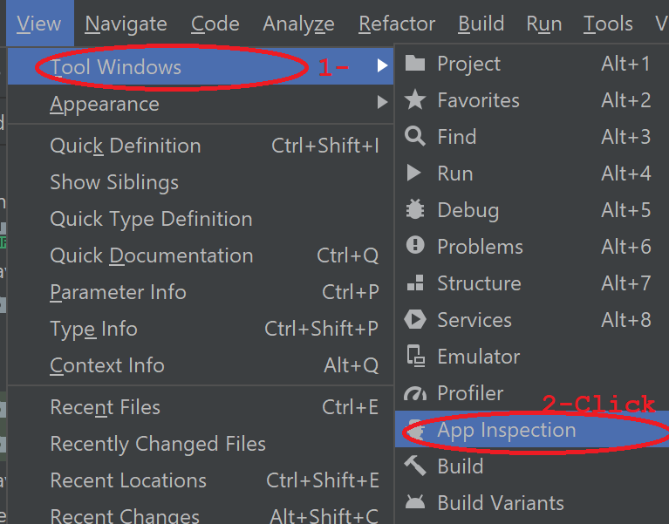
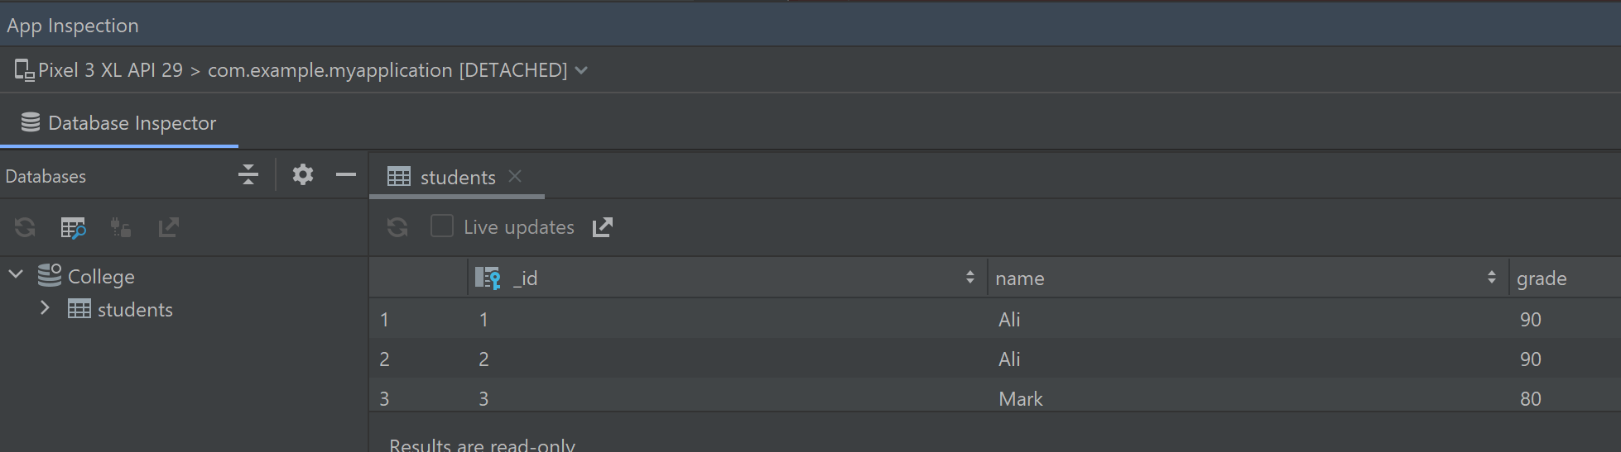
Check DB in Android Studio
Run the application through the emulator, then click view->Tool Windows-> App Inspection.
Click on Database Inspector, you must see College Database, if you expand it, you will see students table.

Slide 20
Query Event
Class MainActiviry:Activity{ ..
fun onClickRetrieveStudents(view: View?) { // Retrieve student records val URL = "content://com.example.MyApplication.StudentsProvider" val students = Uri.parse(URL) //\ val c = contentResolver!!.query(students,null,null,null,"name") var c = contentResolver.query(students, null, null, null,null) //val //c = managedQuery(students, null, null, null, "name") if (c != null) { if (c?.moveToFirst()) { do { Toast.makeText(this, c.getString(c.getColumnIndex(StudentsProvider._ID)) +
", " + c.getString(c.getColumnIndex(StudentsProvider.NAME)) + ", "
+ c.getString(c.getColumnIndex(StudentsProvider.GRADE)), Toast.LENGTH_SHORT).show() } while (c.moveToNext()) } } }
}
Go back to slide 8

Slide 21
References
https://developer.android.com/guide/components/intents-filters
http://borg.csueastbay.edu/~bhecker/Previous%20Terms/CS-453-Fall19/Examples/

